Slide 1
Lec 9: discrete Convolution sum
Dr. Arsla Khan

Slide 2
Convolution
Convolution operation is used to relate the input output relationship for LTI systems.
Importance of convolution stems from the fact that knowledge of response of an LTI system to the unit impulse input allows us to find its output to any input signals.
Convolution can be termed as
Convolution Integral → CT LTI Systems
Convolution Sum → DT LTI Systems

Slide 3
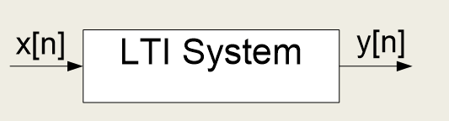

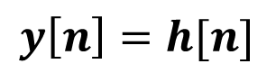
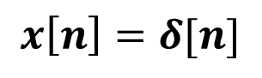
Impulse Response
The impulse response (or unit sample response) $h[n]$ of a discrete-time LTI system is defined to be the output response of the system when the input $x[n]$ is $δ[n]$
$$x\left[n\right]=δ[n]$$
$$y\left[n\right]=h[n]$$

Slide 4
Methods to find Convolution Sum
1) Analytical approach
2) Tabular approach
3) Multiplication approach
4) Graphical / Formula approach

Slide 5
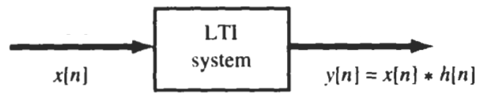

Convolution Sum
Convolution Sum of two sequences $x[n]$ and $h[n]$ is denoted by
$y\left[n\right]=x\left[n\right]∗h\left[n\right]$
$y\left[n\right]=\sum_{k=−∞}^{∞}{x\left[k\right]h[n−k]}$
$y\left[n\right]=\sum_{k=−∞}^{∞}{x\left[n−k\right]h[k]}$
h[n]

Slide 6
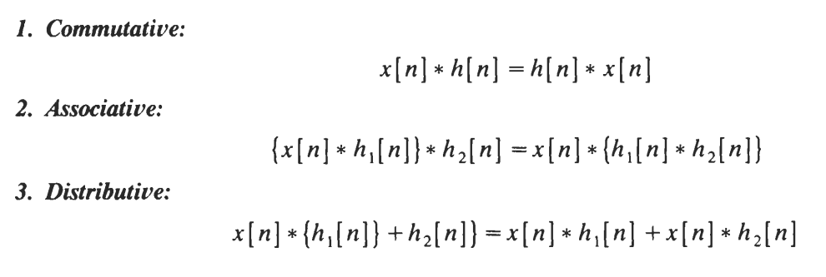
Properties of Convolution Sum

Slide 7

Points to Remember
$x\left[n\right]δ\left[n−n_{o}\right]=x\left[n_{o}\right]$
$x\left[n\right]∗δ\left[n−n_{o}\right]=x\left[n−n_{o}\right]$

Slide 8
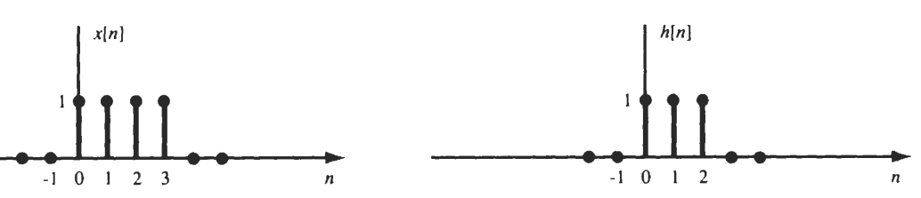
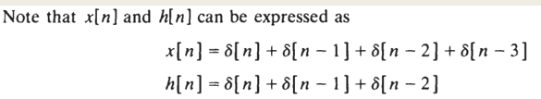

Exp 1: Evaluate $x\left[n\right]$ and $h[n]$ by an analytical technique
Method 1: Analytical Approach

Slide 9
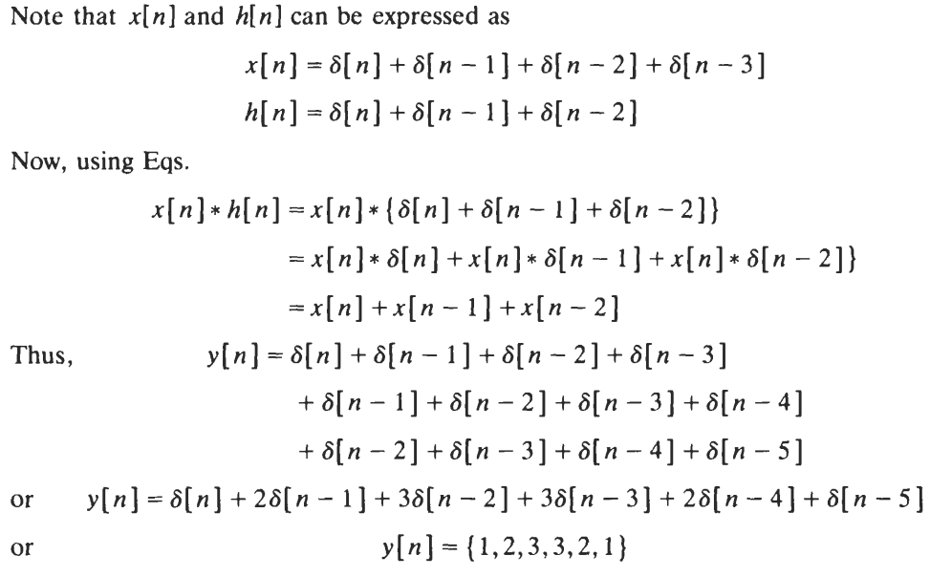

Slide 10
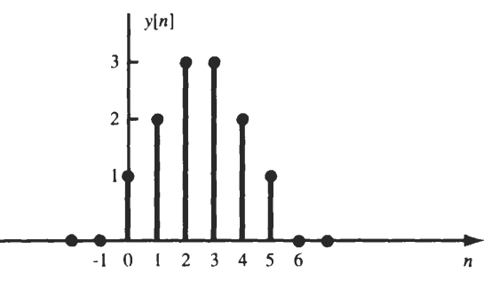

Slide 11
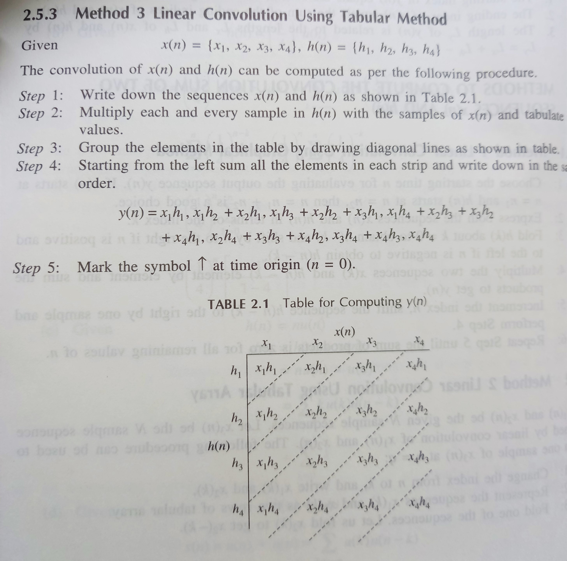
Method 2:
Tabular Approach

Slide 12
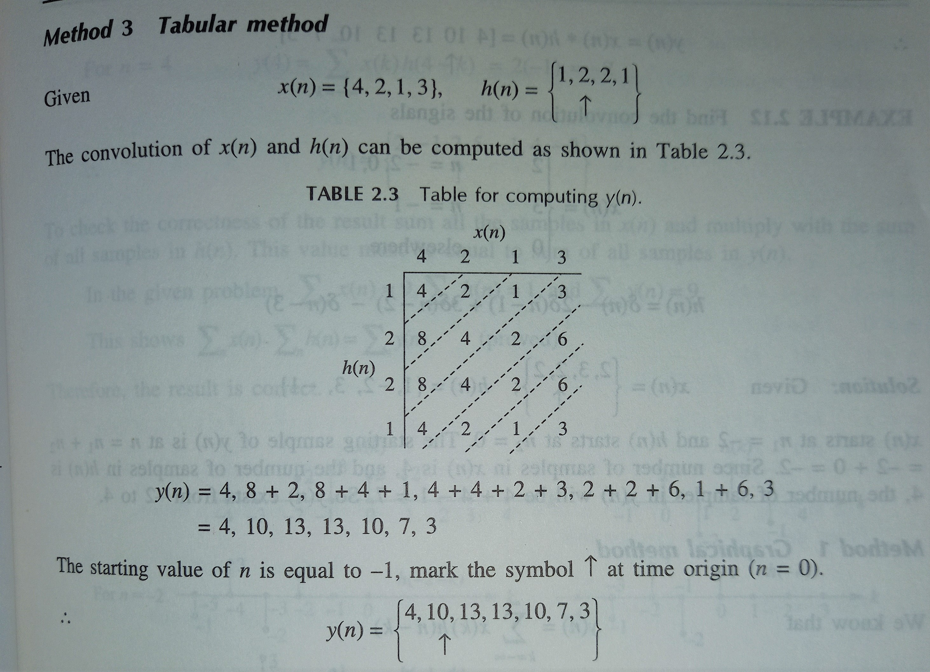
Exp 2:

Slide 13
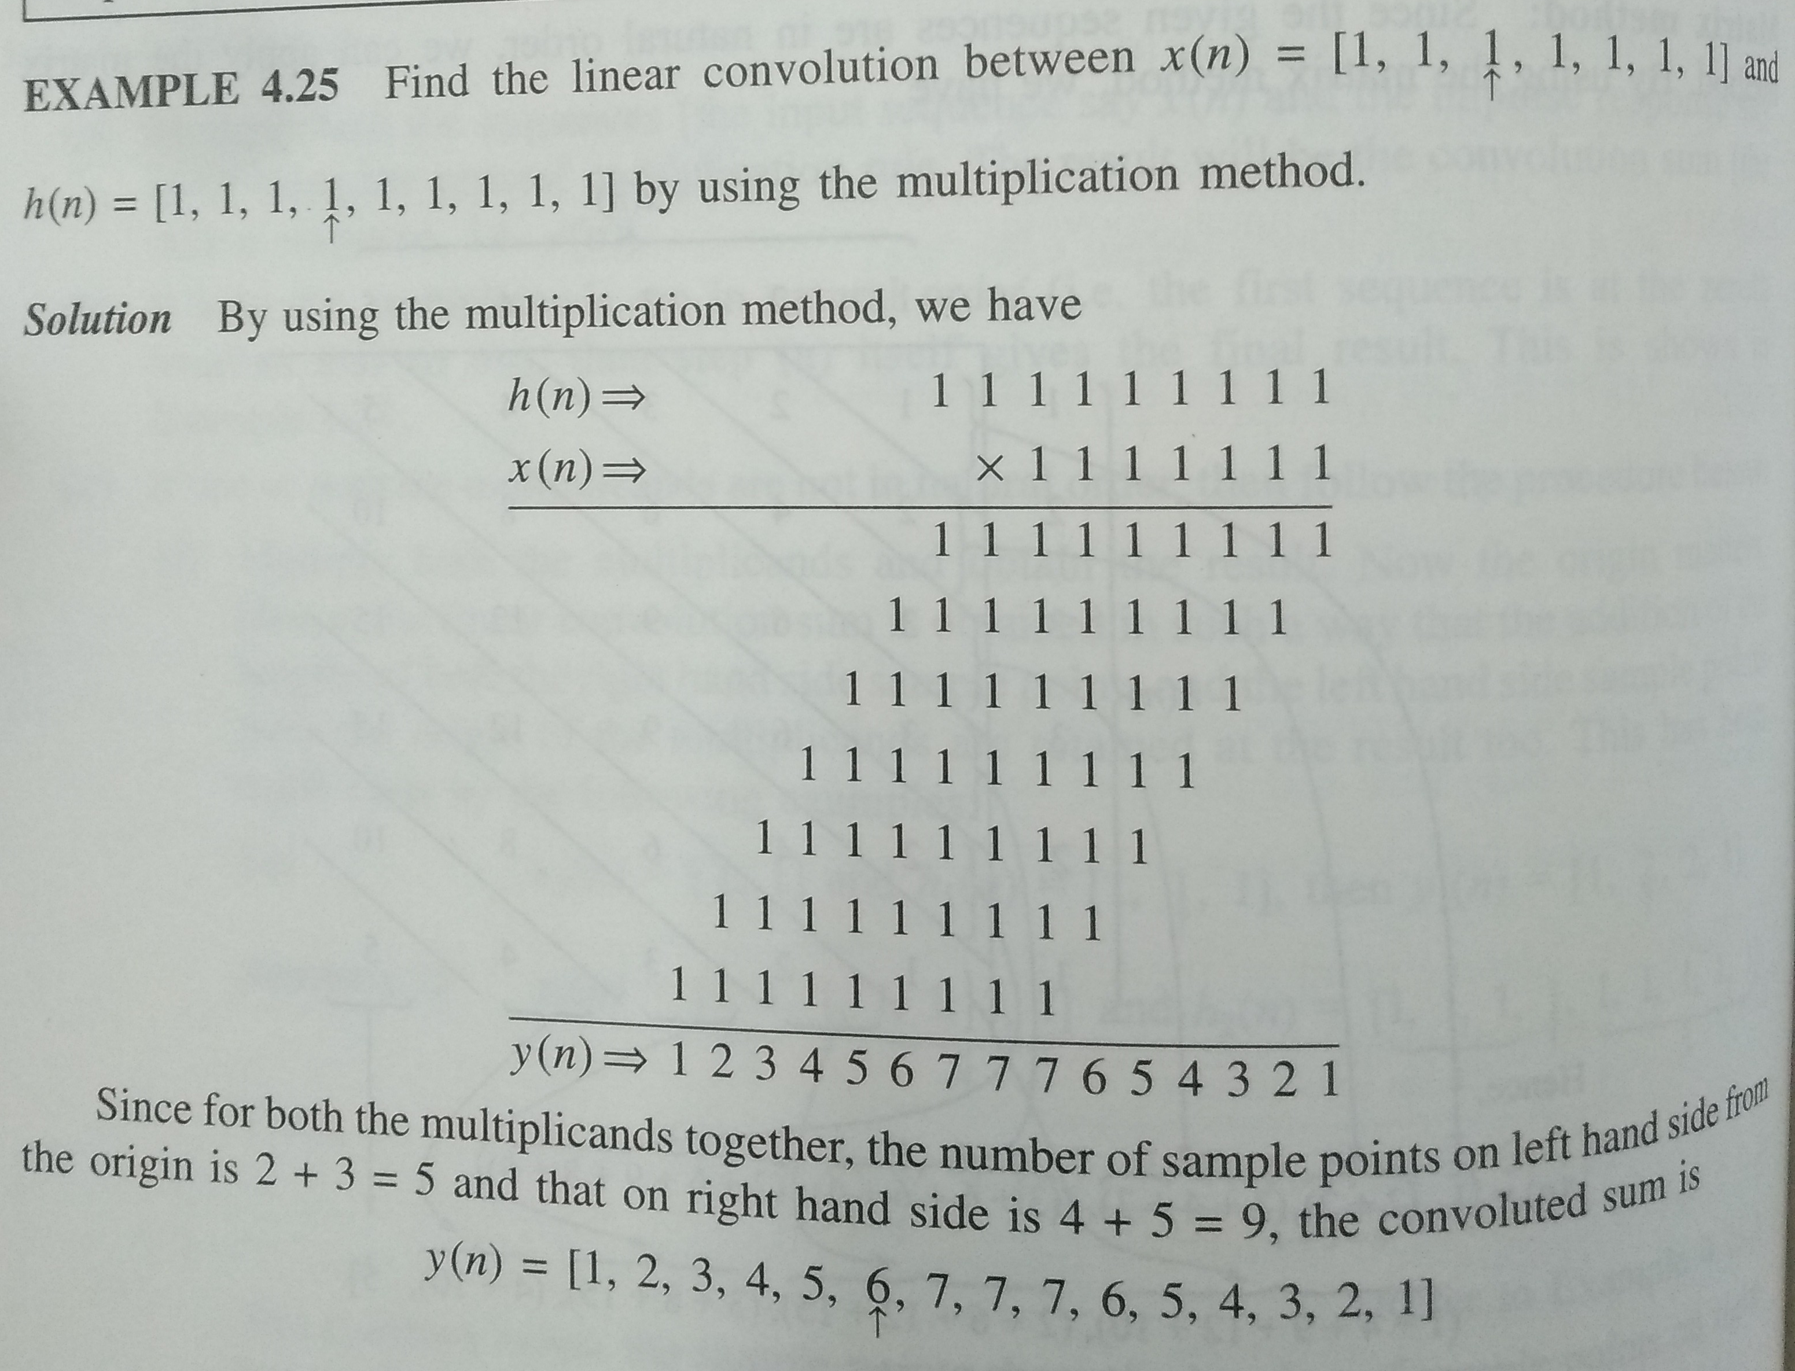
3. Multiplication Method

Slide 14
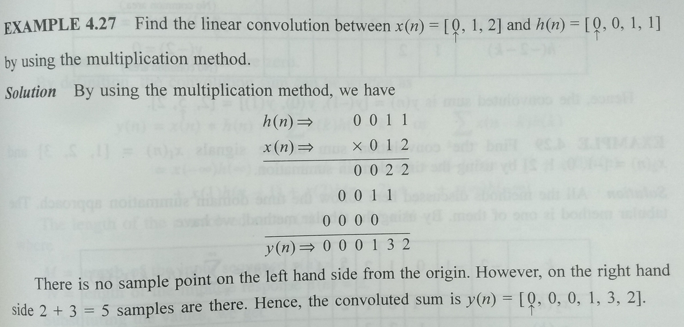

Slide 15


Method 4: Graphical Method Steps to find Convolution Sum Using Formula
Folding: Convert $h[k]$ into $h[−k]$
Shifting: Fix $x[k]$ and shift $h[−k]$ from right to left
Multiplication: Multiply $x[k]$ with $h[n−k]$
Summation: Sum all products
$$y\left[n\right]=\sum_{k=−∞}^{∞}{x\left[k\right]h[n−k]}$$
$$y\left[n\right]=\sum_{k=−∞}^{∞}{x\left[n−k\right]h[k]}$$

Slide 16
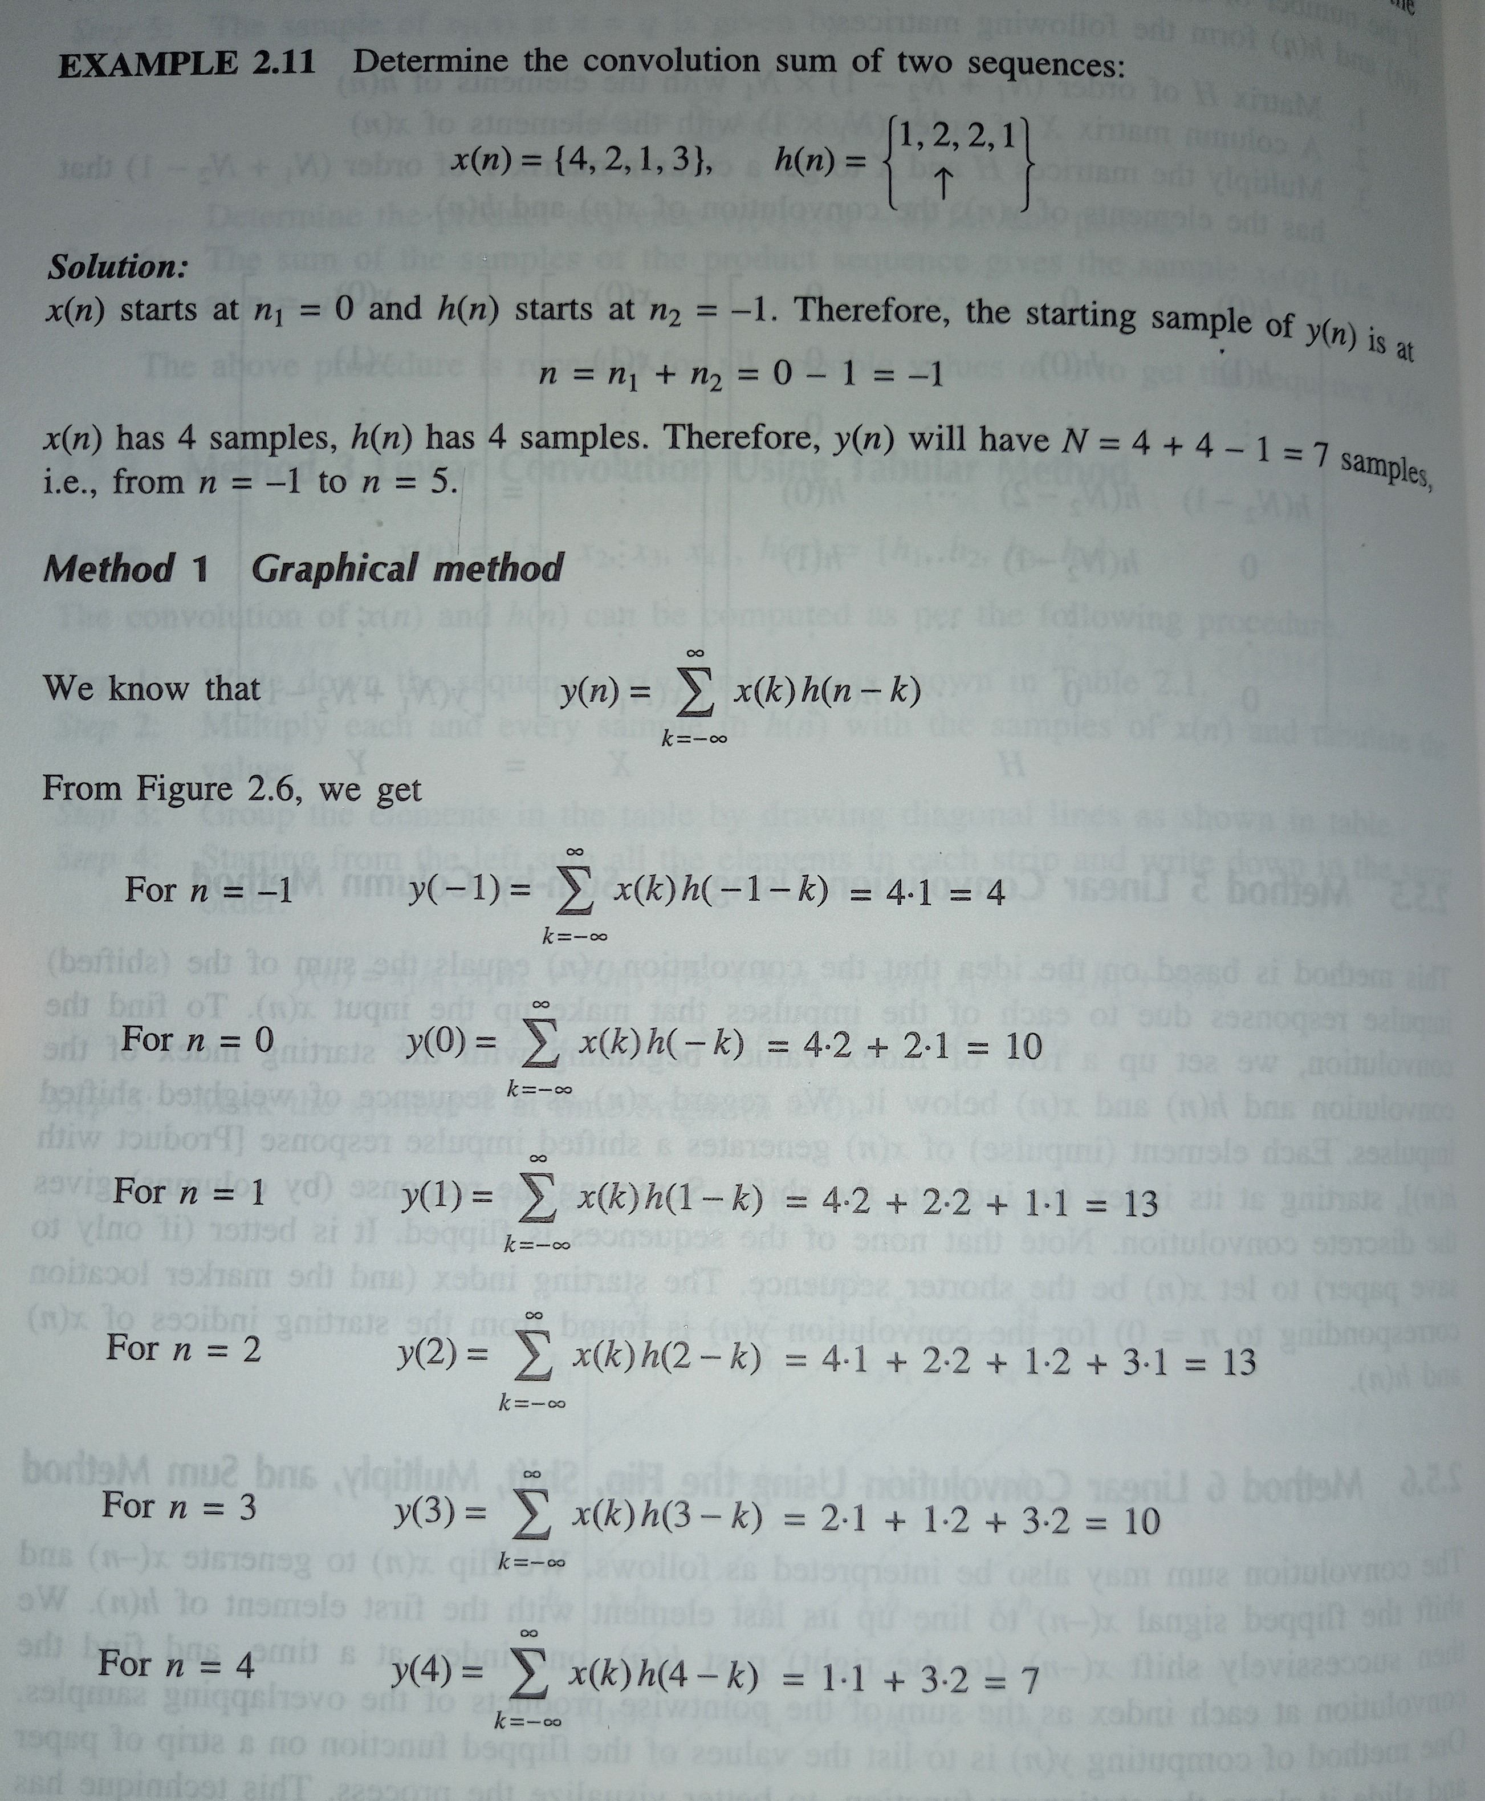
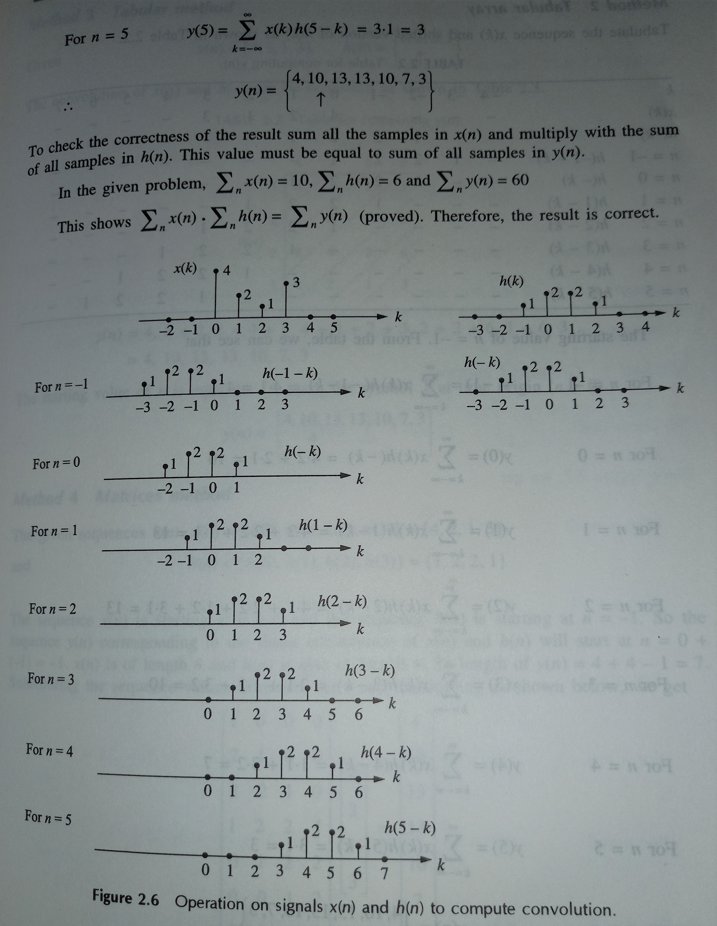

Slide 17

Exp 2: Evaluate $x\left[n\right]$ and $h[n]$ by graphical/ formula technique

Slide 18
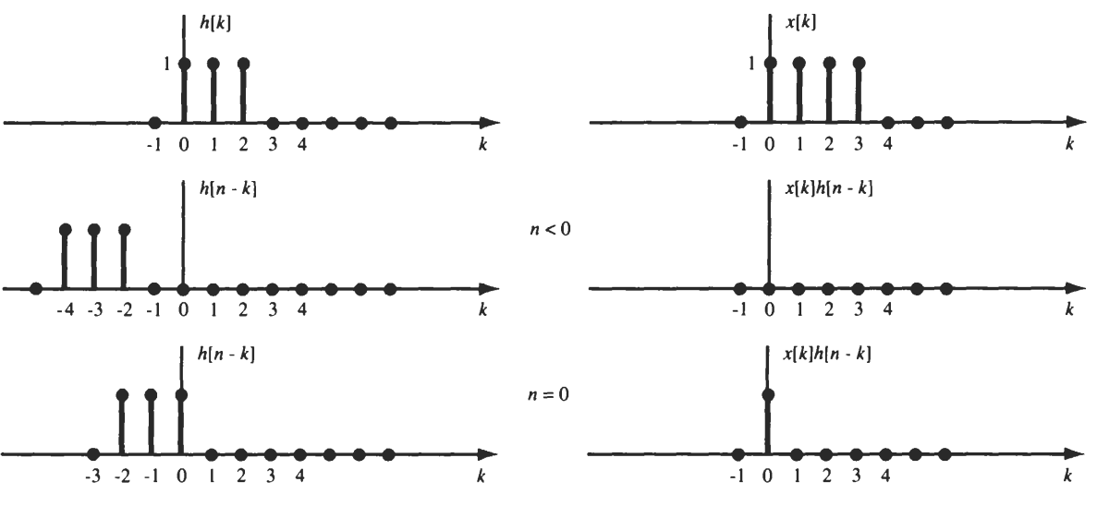

Slide 19
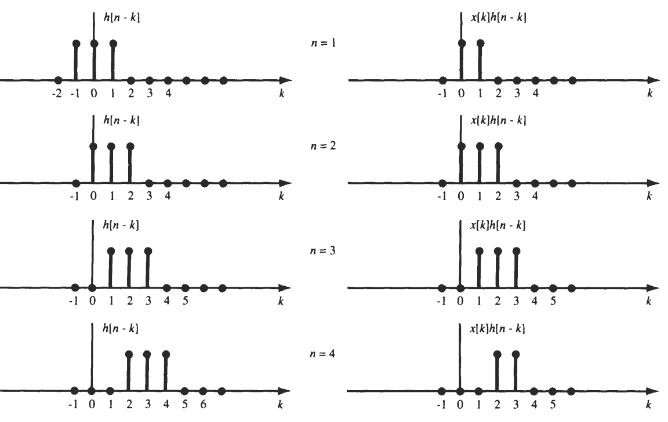

Slide 20
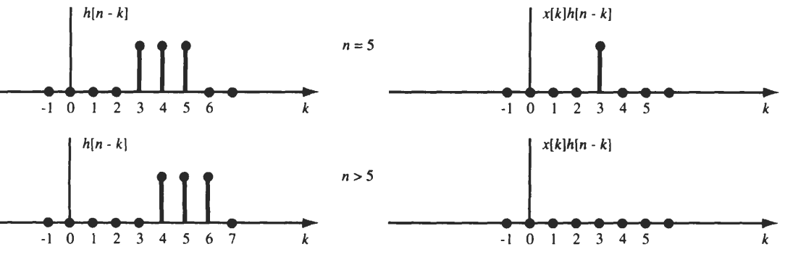
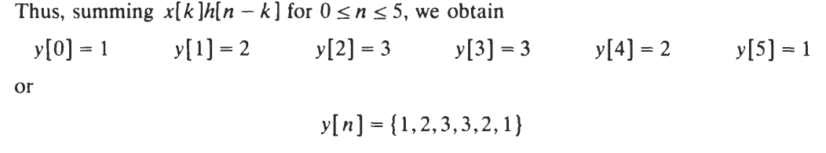

Slide 21
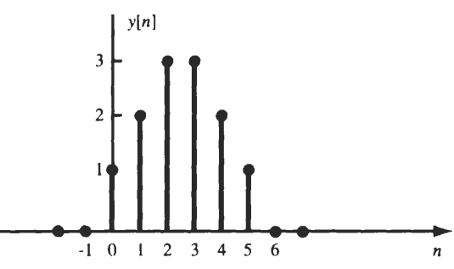

Slide 22
Thank You !!!

